Slide 1
Patient Health Risk Prediction
Decision Tree vs KNN Algorithm
Mohanarangan M
Register No: 717825Z135
Class: II-MCA

Slide 2
Problem Statement
Patient health risk depends on many factors such as age, BMI, blood pressure, glucose, cholesterol, lifestyle habits and chronic conditions.
These factors affect each other, so manual analysis of thousands of patients is slow and difficult.
Machine learning can learn from past patient data and classify a patient as High_Risk or Low_Risk.
KNN and Decision Tree are used because they are simple, popular and very different in how they work.
The project predicts health_risk (High_Risk / Low_Risk) and compares both models on the same dataset.
2

Slide 3
Objectives of the Project
Analyze patient health data (vital signs, lab values, lifestyle, medical history).
Clean the dataset: handle missing values and remove duplicate records.
Study statistical problems such as outliers, skewness, correlation and class imbalance.
Predict whether a patient is High_Risk or Low_Risk using KNN and Decision Tree.
Build regression models (simple, multiple, stepwise and logistic) in R.
Compare all models using accuracy, recall, F1-score, ROC-AUC, R-squared and RMSE.
3

Slide 4
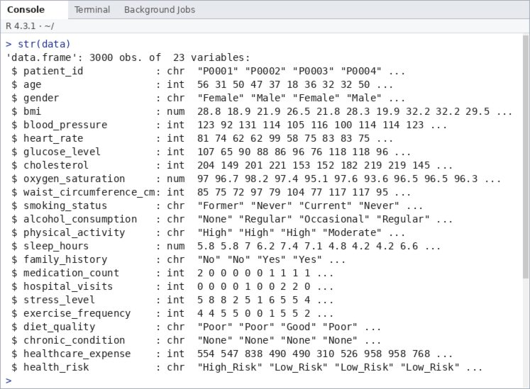
Dataset: Loading and Anatomy
data <- read.csv(file.choose())
str(data)
Dataset: Patient Health Risk Dataset (simulated academic data created in R for demonstration, not real patients)
File: patient_health_risk_dataset.csv
Size: 3000 rows and 23 columns
1 identifier (patient_id), 21 features, 1 target (health_risk: High_Risk / Low_Risk)
Numeric features (14) and categorical features (7)
4

Slide 5
Structure of the Dataset
Feature | Description
patient_id | Unique patient ID
age | Age in years
gender | Male / Female
bmi | Body Mass Index
blood_pressure | Systolic BP (mmHg)
heart_rate | Resting heart rate
glucose_level | Fasting glucose (mg/dL)
cholesterol | Total cholesterol (mg/dL)
oxygen_saturation | Blood oxygen (%)
waist_circumference_cm | Waist size (cm)
smoking_status | Never / Former / Current
alcohol_consumption | None / Occasional / Regular
Feature | Description
physical_activity | Low / Moderate / High
sleep_hours | Sleep per day (hours)
family_history | Yes / No
medication_count | Regular medications
hospital_visits | Visits in last year
stress_level | Score 1 to 10
exercise_frequency | Exercise days per week
diet_quality | Poor / Average / Good
chronic_condition | None / Hypertension / Diabetes / Heart_Disease / Respiratory
healthcare_expense | Annual expense (USD)
health_risk | Target: High_Risk / Low_Risk
5

Slide 6
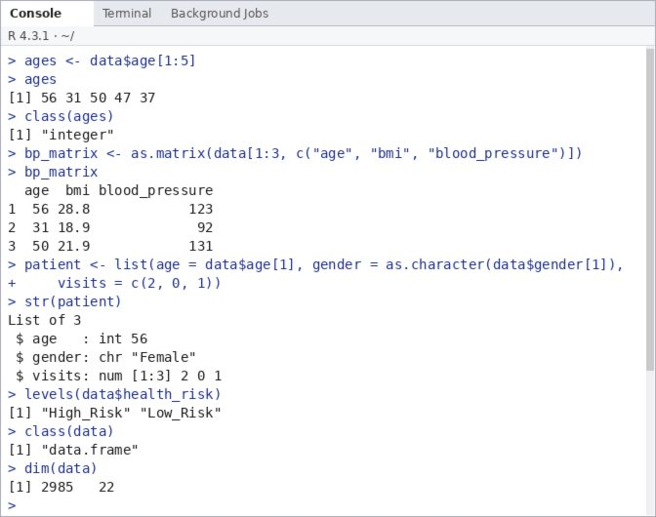
Data Structures in R
Vector: readings of many patients, e.g. age or BMI (like sensor readings)
Matrix: numeric feature table used by KNN
List: a patient record with mixed types
Data frame: 3000 patient records, like a hospital database table
Factor: gender, smoking_status, health_risk
ages <- data$age[1:5] # vector
bp_matrix <- as.matrix(data[1:3,
c("age","bmi","blood_pressure")]) # matrix
patient <- list(age = data$age[1],
gender = as.character(data$gender[1]),
visits = c(2, 0, 1)) # list
levels(data$health_risk) # factor
class(data); dim(data) # data frame
6

Slide 7
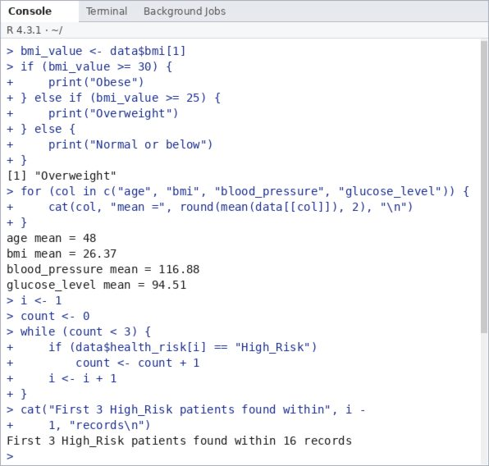
Control Structures and Functions
if (bmi_value >= 30) {
print("Obese")
} else if (bmi_value >= 25) {
print("Overweight")
} else {
print("Normal or below")
}
for (col in c("age","bmi")) {
cat(col, mean(data[[col]]), "\n")
}
while (count < 3) {
if (data$health_risk[i] == "High_Risk")
count <- count + 1
i <- i + 1
}
bmi_category <- function(bmi) {
ifelse(bmi < 18.5, "Underweight",
ifelse(bmi < 25, "Normal",
ifelse(bmi < 30, "Overweight", "Obese")))
}
rmse <- function(actual, predicted)
sqrt(mean((actual - predicted)^2))
if / else: classify BMI
for loop: mean of columns
while loop: first 3 High_Risk patients
Functions: bmi_category() and rmse() are written once and reused
7

Slide 8
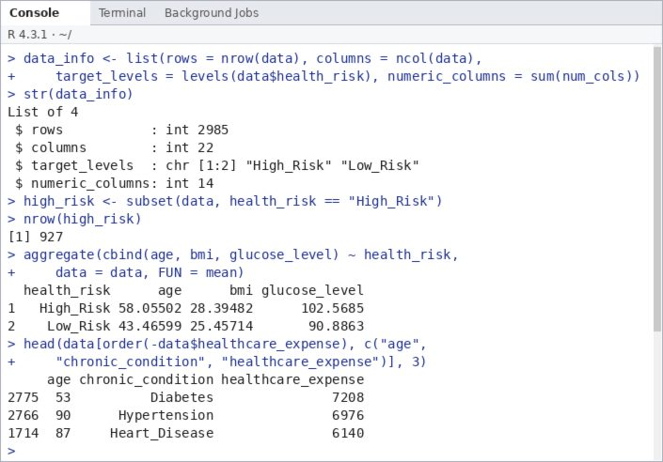
Lists and Data Frames
A list stores different types together (numbers, text, vectors).
A data frame is a table: each row is a patient, each column a variable.
subset(), aggregate() and order() filter, group and sort the data frame.
High_Risk patients are older (mean 58.1 vs 43.5) and have higher glucose (102.6 vs 90.9).
data_info <- list(rows = nrow(data), ...)
str(data_info)
high_risk <- subset(data,
health_risk == "High_Risk")
aggregate(cbind(age, bmi, glucose_level)
~ health_risk, data = data, FUN = mean)
8

Slide 9
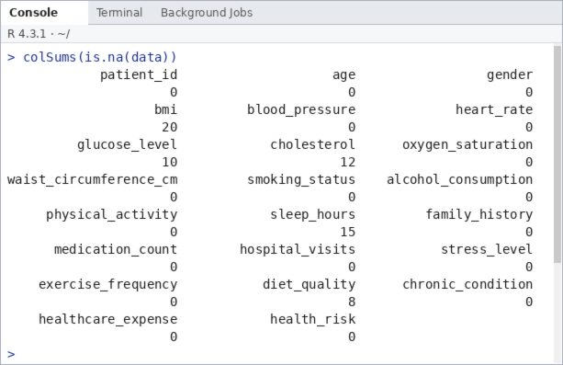
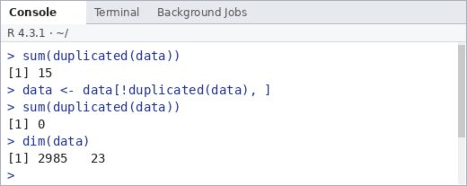
Stage 1: Data Cleaning
65 missing values in 5 columns (bmi 20, glucose 10, cholesterol 12, sleep 15, diet 8)
Numeric columns filled with the median, categorical with the mode
15 duplicate records found and removed (2985 rows remain)
colSums(is.na(data))
for (col in names(data)) {
if (anyNA(data[[col]])) {
if (is.numeric(data[[col]])) {
data[[col]][is.na(data[[col]])] <-
median(data[[col]], na.rm = TRUE)
} else {
mode_val <- names(which.max(table(data[[col]])))
data[[col]][is.na(data[[col]])] <- mode_val
}
}
}
sum(duplicated(data))
data <- data[!duplicated(data), ]
9

Slide 10
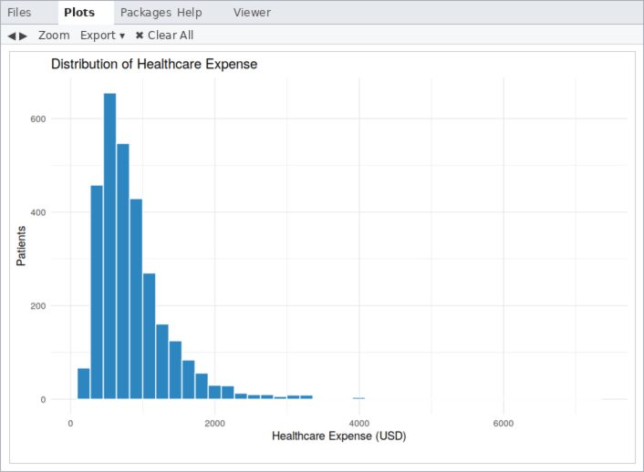
Statistical Problems in the Project
Missing values and duplicates (cleaned)
Class imbalance: only 31.06% High_Risk
Outliers: healthcare_expense has 152 IQR outliers, glucose_level 23
Skewness: healthcare_expense is right-skewed
Multicollinearity: bmi and waist circumference, r = 0.88
Different scales: needs standardization for KNN
healthcare_expense is skewed to the right.
10

Slide 11
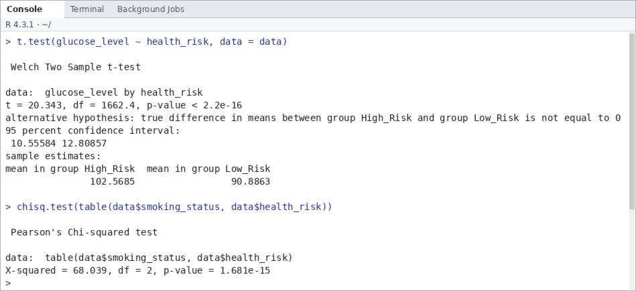
Statistical Problems – Hypothesis Tests
t-test: glucose_level differs between risk groups (t = 20.34, p < 2.2e-16). High_Risk mean 102.57 vs Low_Risk 90.89.
Chi-square test: smoking_status is associated with health_risk (X-squared = 68.04, df = 2, p = 1.68e-15).
Both p-values are far below 0.05, so these variables are useful predictors.
11

Slide 12
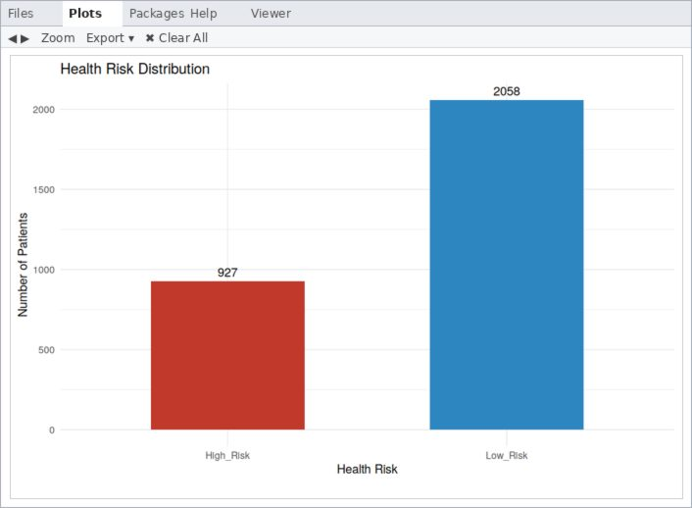
Stage 2: Data Visualization
A bar chart compares High_Risk and Low_Risk patients.
High_Risk: 927 (31.06%)
Low_Risk: 2058 (68.94%)
The classes are imbalanced, so accuracy alone is not enough.
ggplot(data, aes(x = health_risk,
fill = health_risk)) +
geom_bar(width = 0.55) +
geom_text(stat = "count",
aes(label = after_stat(count)),
vjust = -0.5) +
scale_fill_manual(values = c(
"High_Risk" = "#C0392B",
"Low_Risk" = "#2E86C1")) +
labs(title = "Health Risk Distribution",
x = "Health Risk",
y = "Number of Patients") +
theme_minimal() +
theme(legend.position = "none")
12

Slide 13
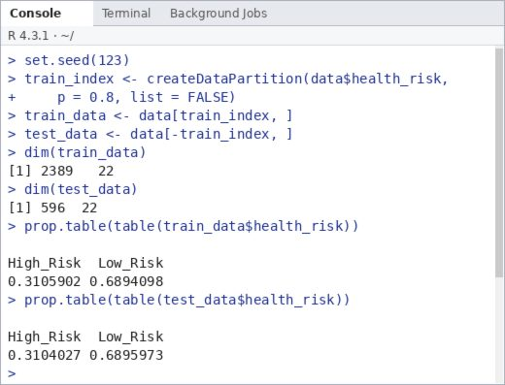
Stage 3 and 4: Data Preparation and Splitting
health_risk converted to a factor; patient_id removed; characters converted to factors
80% training (2389), 20% testing (596) with set.seed(123)
Class ratio is almost the same in both sets
KNN data is dummy-coded and standardized using training values
data$health_risk <- factor(data$health_risk,
levels = c("High_Risk", "Low_Risk"))
data$patient_id <- NULL
char_cols <- sapply(data, is.character)
data[char_cols] <- lapply(data[char_cols], as.factor)
set.seed(123)
train_index <- createDataPartition(
data$health_risk, p = 0.8, list = FALSE)
train_data <- data[train_index, ]
test_data <- data[-train_index, ]
13

Slide 14
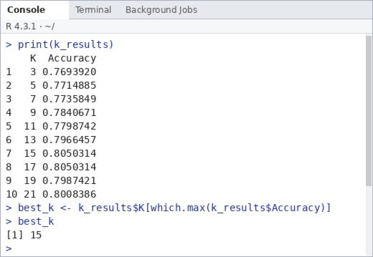
Stage 5: ML Model Training
Two models: KNN and Decision Tree
KNN uses standardized data; K = 3 to 21 tested on a validation set
Best K = 15 (validation accuracy 80.50%)
Decision Tree is pruned to avoid overfitting
x_all <- model.matrix(health_risk ~ . - 1, data = data)
x_train <- x_all[train_index, ]
x_test <- x_all[-train_index, ]
train_mean <- colMeans(x_train)
train_sd <- apply(x_train, 2, sd)
x_train_s <- scale(x_train, train_mean, train_sd)
x_test_s <- scale(x_test, train_mean, train_sd)
y_train <- train_data$health_risk
y_test <- test_data$health_risk
set.seed(123)
val_index <- createDataPartition(y_train, p = 0.8, list = FALSE)
k_values <- seq(3, 21, by = 2)
k_acc <- sapply(k_values, function(k) {
pred <- knn(x_train_s[val_index, ], x_train_s[-val_index, ],
cl = y_train[val_index], k = k)
mean(pred == y_train[-val_index])
})
k_results <- data.frame(K = k_values, Accuracy = k_acc)
best_k <- k_results$K[which.max(k_results$Accuracy)]
14

Slide 15
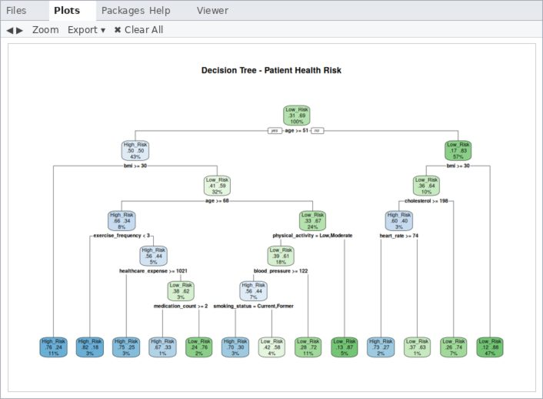
Decision Tree
Classifies using if-else rules
Root node: first split (age >= 51)
Branches: each split sends patients left or right
Leaf nodes: final class
A patient follows branches from root to a leaf
Pruned with cp = 0.0074; 12 splits, 13 leaves
tree_full <- rpart(health_risk ~ .,
data = train_data, method = "class",
control = rpart.control(cp = 0.001,
minsplit = 20, maxdepth = 6))
best_cp <- tree_full$cptable[
which.min(tree_full$cptable[, "xerror"]),"CP"]
tree_model <- prune(tree_full, cp = best_cp)
rpart.plot(tree_model, type = 2, extra = 104,
fallen.leaves = TRUE)
15

Slide 16
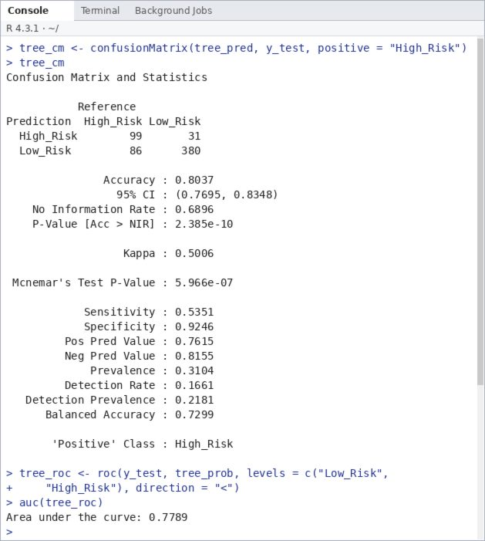
Decision Tree: Prediction and Evaluation
Accuracy: 80.37%
Precision: 76.15%, Recall: 53.51%
Specificity: 92.46%, F1: 62.86%
Balanced Accuracy: 72.99%
ROC-AUC: 0.7789
Found 99 of 185 High_Risk patients, missed 86
tree_pred <- predict(tree_model, test_data,
type = "class")
tree_cm <- confusionMatrix(tree_pred, y_test,
positive = "High_Risk")
tree_cm
16

Slide 17
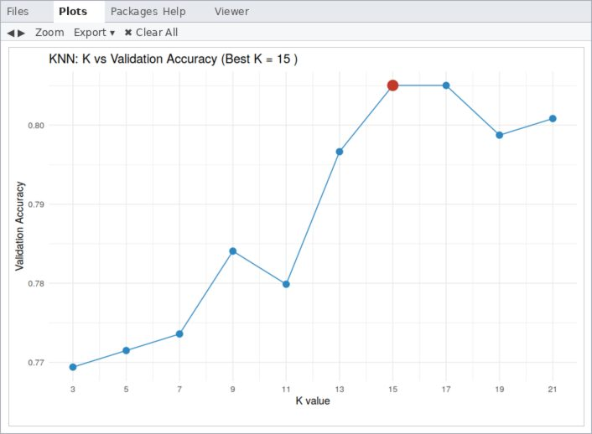
KNN – K-Nearest Neighbors
A supervised classification algorithm
Finds the K nearest patients; the majority class is the prediction
Scaling is important because KNN uses distance
Best K = 15 (80.50% validation accuracy; K = 17 gave the same value)
knn_pred <- knn(x_train_s, x_test_s,
cl = y_train, k = best_k, prob = TRUE)
17

Slide 18
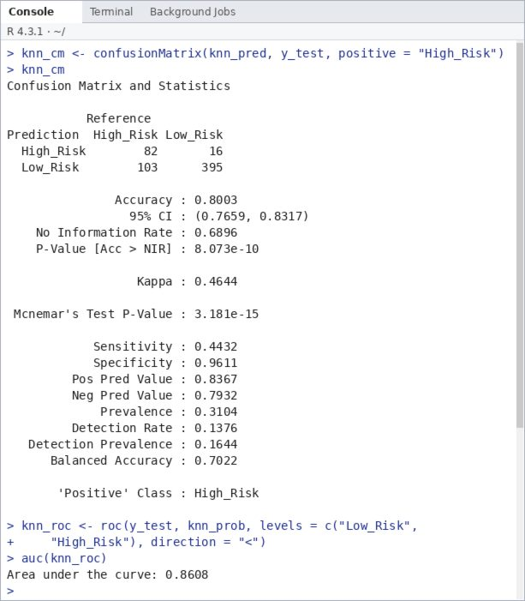
KNN: Prediction and Evaluation
Accuracy: 80.03%
Precision: 83.67%, Recall: 44.32%
Specificity: 96.11%, F1: 57.95%
Balanced Accuracy: 70.22%
ROC-AUC: 0.8608
Found 82 of 185 High_Risk patients, missed 103
knn_cm <- confusionMatrix(knn_pred, y_test,
positive = "High_Risk")
knn_cm
18

Slide 19
KNN vs Decision Tree – Comparison
Parameter | KNN | Decision Tree
Best Parameters | K = 15 | cp = 0.0074, maxdepth = 6
Data Scaling | Required | Not required
Confusion (TN / FP / FN / TP) | 395 / 16 / 103 / 82 | 380 / 31 / 86 / 99
Accuracy | 80.03% | 80.37%
Precision | 83.67% | 76.15%
Recall | 44.32% | 53.51%
Specificity | 96.11% | 92.46%
F1 Score | 57.95% | 62.86%
Balanced Accuracy | 70.22% | 72.99%
ROC-AUC | 0.8608 | 0.7789
Interpretability | Less interpretable | Easy to interpret
Main Limitation | Low recall for High_Risk | More false positives
19

Slide 20
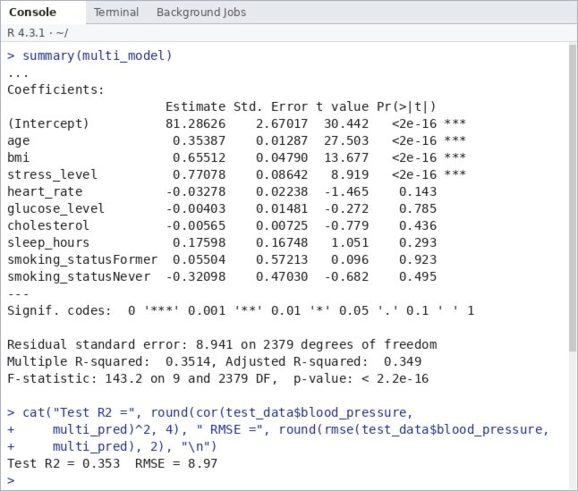
Regression Models in R
Same 80/20 split. Linear models predict blood_pressure; logistic regression predicts health_risk.
Simple: BP = 99.08 + 0.369 x age (each year adds about 0.37 mmHg)
Multiple: age, bmi and stress_level are significant (p < 0.001)
Stepwise (AIC): keeps age, bmi, heart_rate, waist, alcohol, medications, stress
Model | R-squared | RMSE | MAE
Simple Linear | 0.2363 | 9.7474 | 7.8501
Multiple Linear | 0.353 | 8.9707 | 7.1149
Stepwise | 0.3481 | 9.0065 | 7.1358
simple_model <- lm(blood_pressure ~ age, data = train_data)
multi_model <- lm(blood_pressure ~ age + bmi + stress_level + ..., data = train_data)
step_model <- step(full_model, direction = "both", trace = 0)
20

Slide 21
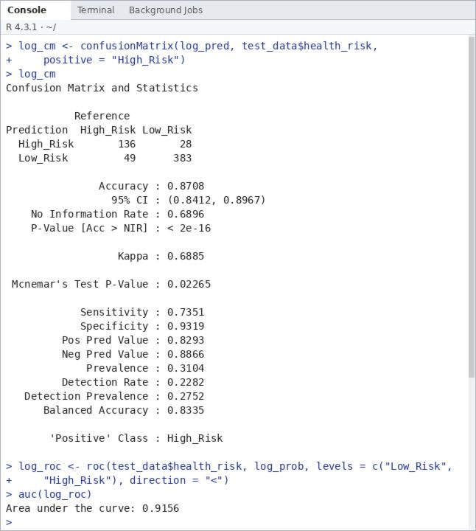
Logistic Regression
Predicts the probability of High_Risk (threshold 0.5)
Accuracy: 87.08%
Precision: 82.93%, Recall: 73.51%
Specificity: 93.19%, F1: 77.94%
Balanced Accuracy: 83.35%, ROC-AUC: 0.9156
TP = 136, TN = 383, FP = 28, FN = 49
log_model <- glm(I(health_risk == "High_Risk") ~
. - chronic_condition, data = train_data,
family = binomial)
log_prob <- predict(log_model, test_data,
type = "response")
21

Slide 22
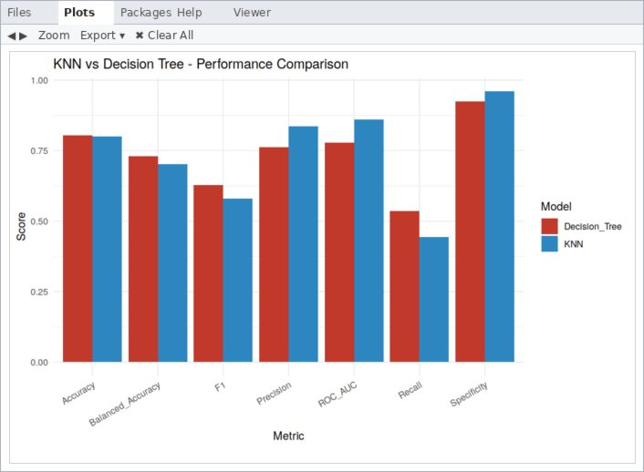
Model Comparison Chart
Decision Tree: higher recall and F1
KNN: higher precision and ROC-AUC
Logistic regression (not in chart) scored higher: accuracy 87.08%, AUC 0.9156
22

Slide 23
Results and Discussion
Decision Tree accuracy 80.37% vs KNN 80.03%, almost equal.
Decision Tree had higher recall (53.51% vs 44.32%) and F1-score (62.86% vs 57.95%); KNN had higher precision, specificity and ROC-AUC (0.8608 vs 0.7789).
KNN missed 103 High_Risk patients; the Decision Tree missed 86. Missing a High_Risk patient delays treatment, so recall matters most and the Decision Tree is more suitable and easy to interpret.
Both recalls are below 55% because only about 31% of patients are High_Risk.
Logistic regression did better than both: accuracy 87.08%, recall 73.51%, AUC 0.9156.
Multiple linear regression predicted blood pressure best (R-squared 0.353, RMSE 8.9707).
23

Slide 24
Conclusion
KNN, Decision Tree and regression models were built in R using a simulated healthcare dataset of 2985 cleaned records.
KNN (K = 15) reached 80.03% accuracy; Decision Tree reached 80.37%. Between the two, the Decision Tree is better because it finds more High_Risk patients and gives clear rules.
Logistic regression was the best classifier overall (87.08% accuracy, AUC 0.9156).
Future work: balance the classes, tune the threshold, use cross-validation, try Random Forest, and test on real clinical data.
24

Slide 25
THANK YOU
Student: Mohanarangan M
Register No: 717825Z135

